Slide 1
Introducing Keyman
Keyman is created by SIL International

Slide 2

SIL @ NPIC
The SIL Language Software Development Unit at NPIC started work in May 2017
Our first project at NPIC will be Keyman

Slide 3

What is Keyman?
The Keyman project is a set of Open Source tools for creating and using keyboard layouts for any language in the world

Slide 4
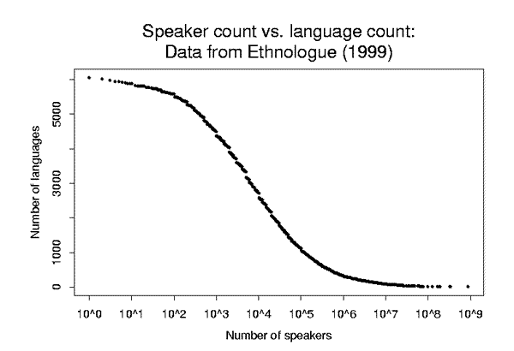
Why does Keyman exist?
Industry supports about 200 languages
Top priority on Latin script
But! 7,099 world languages
Cambodia – 19 languages
Thailand – 50 languages
Laos – 71 languages
Myanmar – 112 languages
Papua New Guinea – 839 languages!
Keyman supports the “long tail” of languages
Keyman
Industry Support
Data from ethnologue.com

Slide 5
Why use Keyman?
Keyman was born in South-East Asia
Keyman emphasises equal support for all languages:
South-East Asian languages
Indic languages
Right-to-left scripts such as Arabic
Minority languages

Slide 6
Who uses Keyman?
SIL members worldwide and associates – many thousands
Large multilingual organisations, e.g. BBC World Service
Governments, e.g. Indian state governments, Canada, Australia
Non Government Organisations – many around the world
Individuals and businesses – thousands more each week

Slide 7
Keyman works on many systems
Windows
Mac OS X
Android
iPhone and iPad
Web
Linux (with the Keyman KMFL clone)

Slide 8
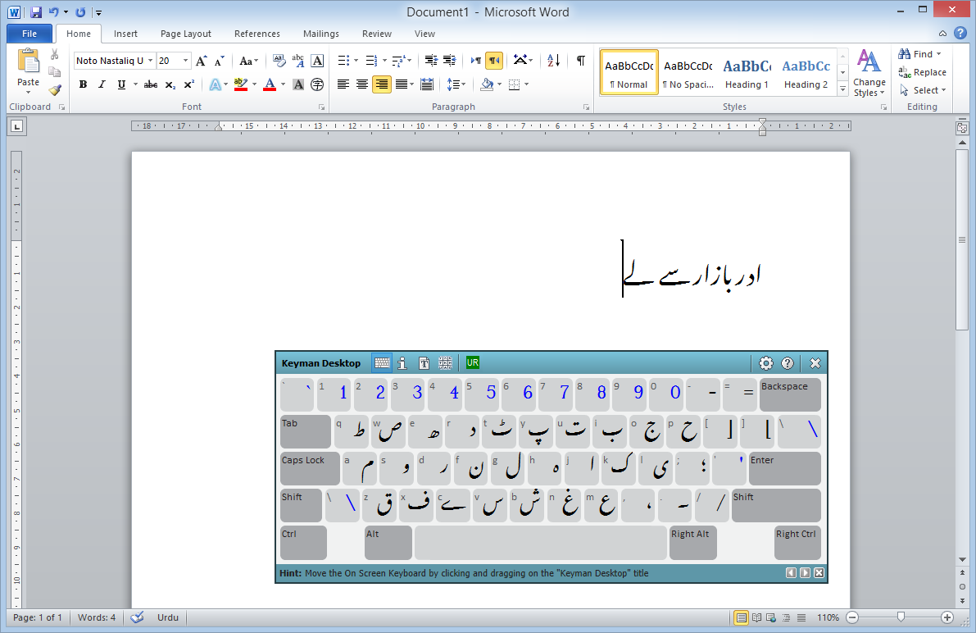

Keyman runs on Windows

Slide 9

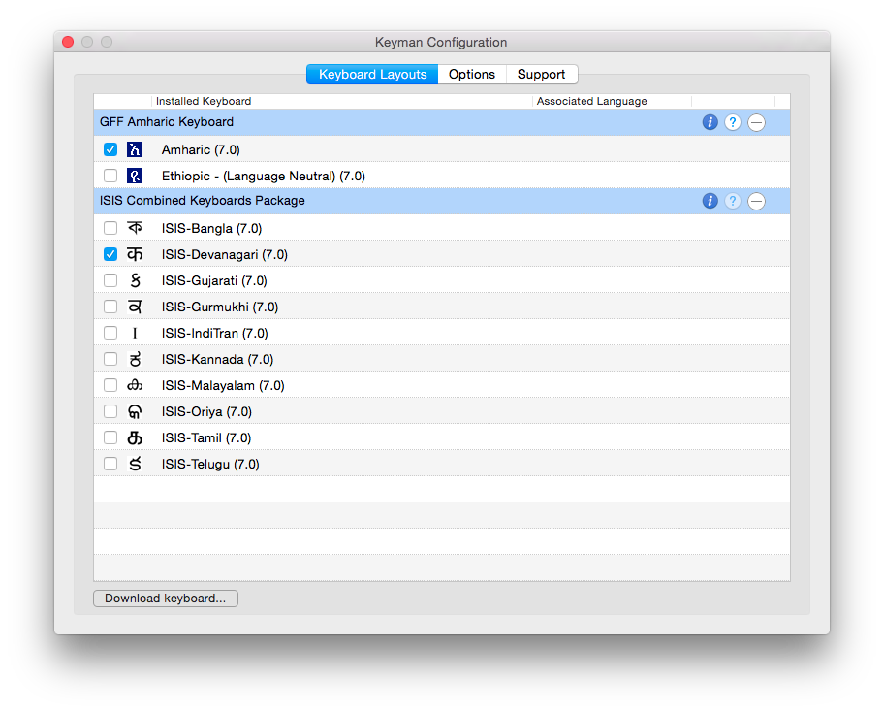
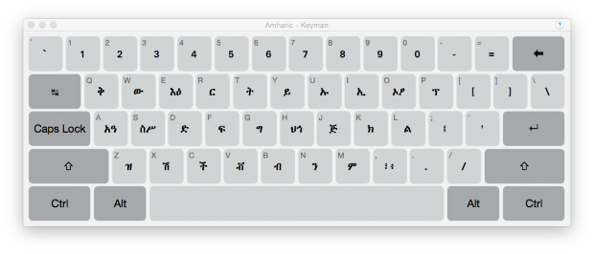
Keyman runs on Mac OS X

Slide 10
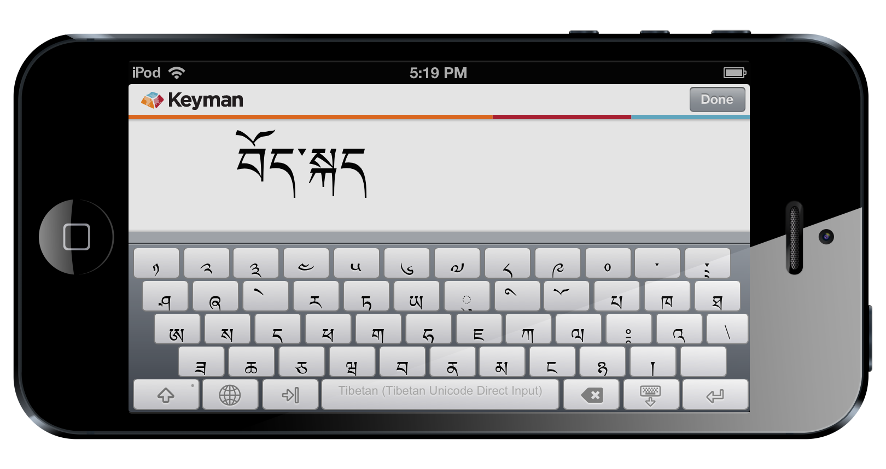
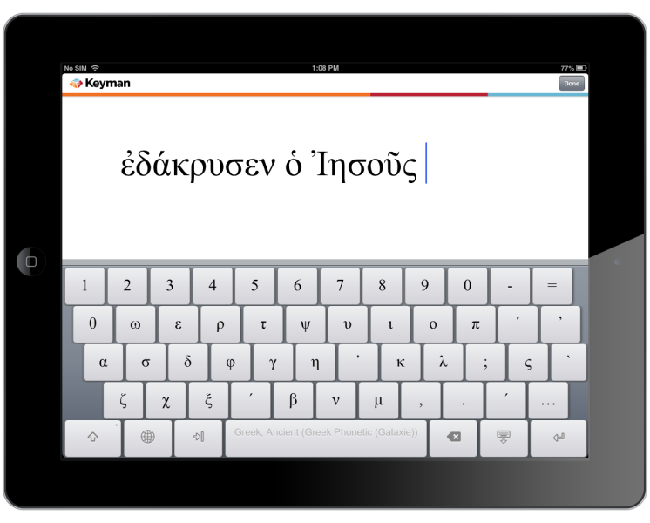

Keyman runs on iPhone and iPad

Slide 11
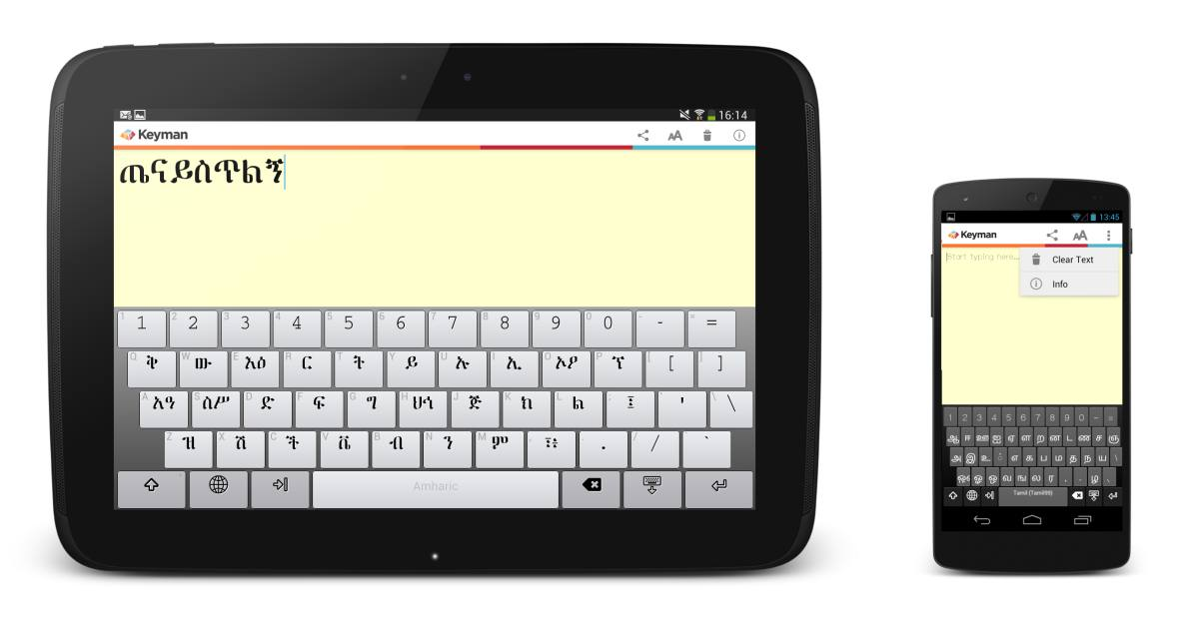

Keyman runs on Android

Slide 12
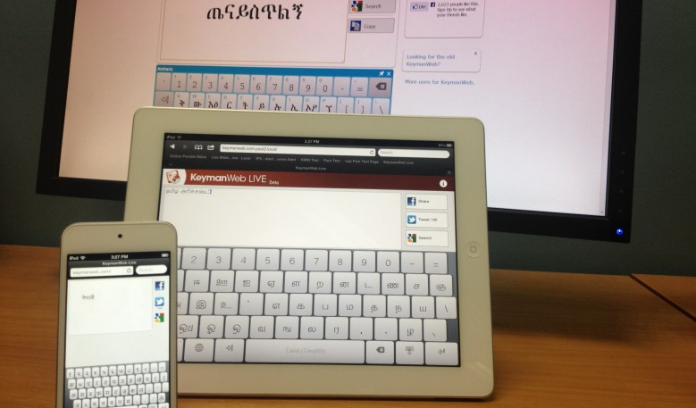

Keyman runs on the Web
Desktop and mobile
www.keymanweb.com

Slide 13

Keyman even runs on Linux
A Keyman clone called KMFL is available for Linux
kmfl.sourceforge.net

Slide 14

A Brief History of Keyman
1992 – Keyman 1.0
For Windows 3.1
Lao language
Not Unicode
1994 – Keyman 3.0
Still for Windows 3.x
Supported user-defined keyboard layouts
Used for many languages in South East Asia and elsewhere
1996 – SILKey
Clone of Keyman released for Mac OS 9
Am I a cute icon or what?

Slide 15


A Brief History of Keyman
2000 – Keyman 5.0
Unicode support
2002 – Keyman 6.0
Windows XP means Unicode starts to become better used
2006 – KeymanWeb 1.0
Keyman keyboards run as JavaScript on WWW

Slide 16

A Brief History of Keyman
2013 – Keyman for iPhone and iPad
2014 – Keyman for Android
2014 – KeymanWeb 2.0 is Open Source
Supports desktop and mobile browsers
2014 – Keyman Desktop 9.0
Deep support for Windows 8 and later versions
2015 – Keyman for Mac OS X
First beta release
2015 – SIL acquires Keyman

Slide 17
Why use Keyman?
?
?
Keyman advantages
Open source
Robust and well supported
Library of existing keyboard layouts
On-screen and hardware keyboards
Unique features
Cross-platform
Development tools
Powerful and flexible keyboard layouts
?
?

Slide 18


Advantage: Open Source
The Keyman project is going completely Open Source
This will be our initial goal at NPIC
https://github.com/keymanapp

Slide 19
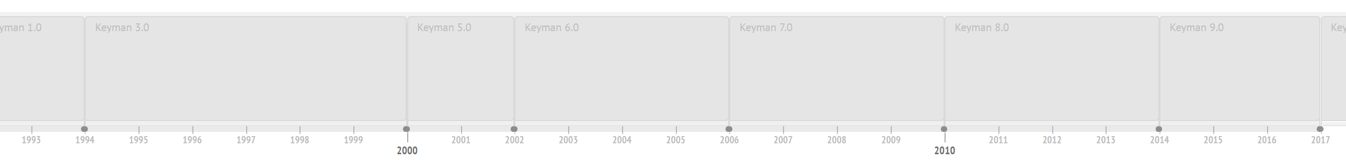
Advantage: Robust and well supported
Keyman Desktop has been under active development for 25 years
Keyman-specific support in many products, e.g. LibreOffice, Firefox
Microsoft have even added features in Windows to support Keyman

Slide 20
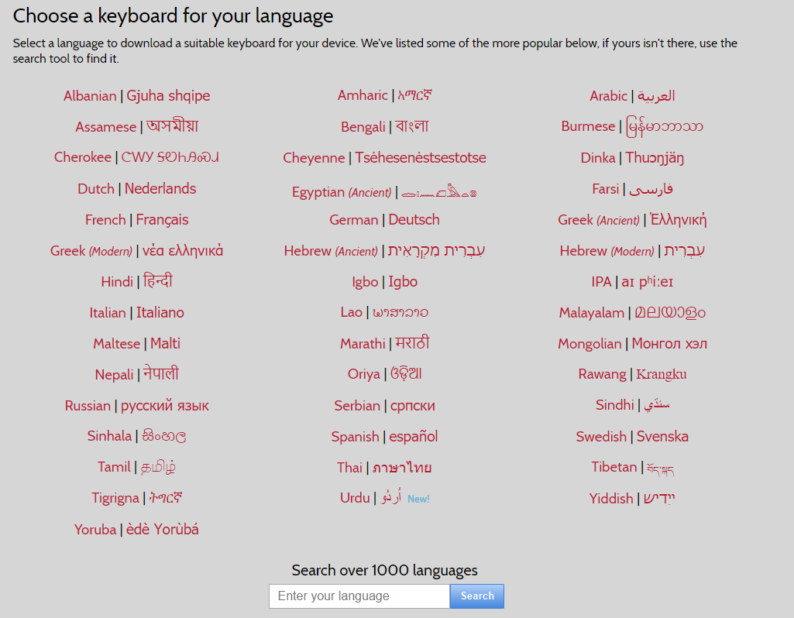
Advantage: Library of keyboard layouts
Over 1,000 different languages
Many languages have multiple layouts
Future goal: Full source code for all layouts

Slide 21

Feature: Cross-platform
Every platform has a different input method system
There are no other established open multi-platform input method systems
Keyman provides a common base system for input methods
Develop a keyboard layout once, use it everywhere

Slide 22
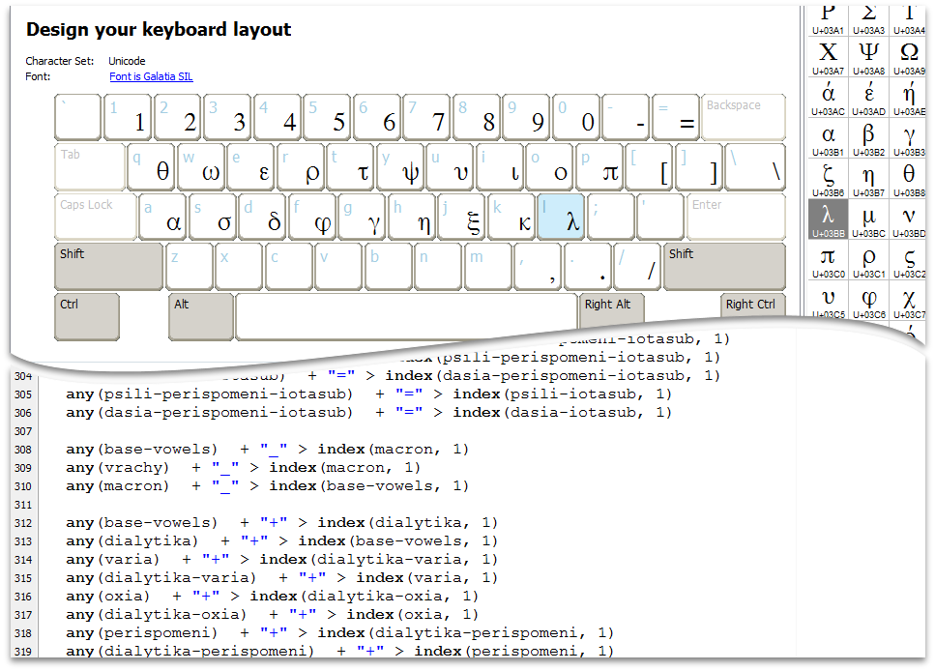
Feature: Development Tools
Keyman has powerful tools to create keyboard layouts
Visual and code-based tools
We will introduce Keyman Developer in the next session

Slide 23
Vision: LDML + Unicode
SIL have been asked by the Unicode Consortium to develop an open standard for keyboard layouts
Keyman will be the reference platform for this open standard
Brings the opportunity to be visible on the global stage as the standard is finalised and implemented by major industry vendors
More about LDML and Unicode on Thursday

Slide 24
Developing Keyboards

Slide 25
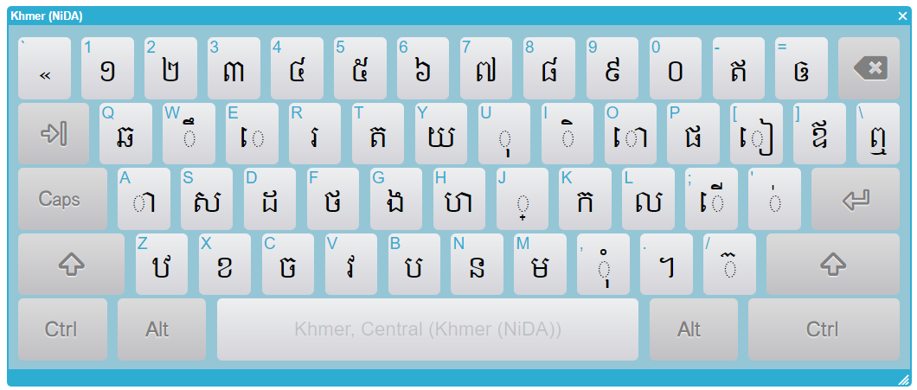
A Keyman Developer Tutorial
An introduction to creating Keyman keyboards based on Khmer NiDA keyboard

Slide 26
Discussion Questions
Is it easy to learn to type Khmer with Unicode?
Can you remember learning to type?
What sorts of problems did you experience?
Did you learn to type on Khmer Limon keyboard?
Was it easy to move to Khmer NiDA?

Slide 27
Our first word of the day
ខ្មែរ

Slide 28
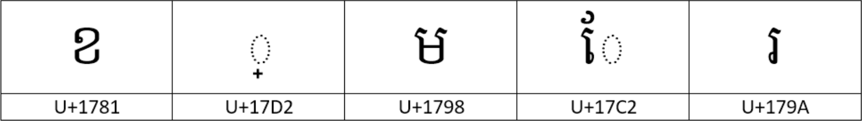
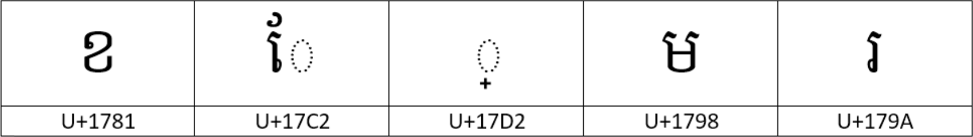
Encoding “ខ្មែរ”
First, understand the encoding
ខ្មែរ in Unicode is encoded as:
or as:

Slide 29
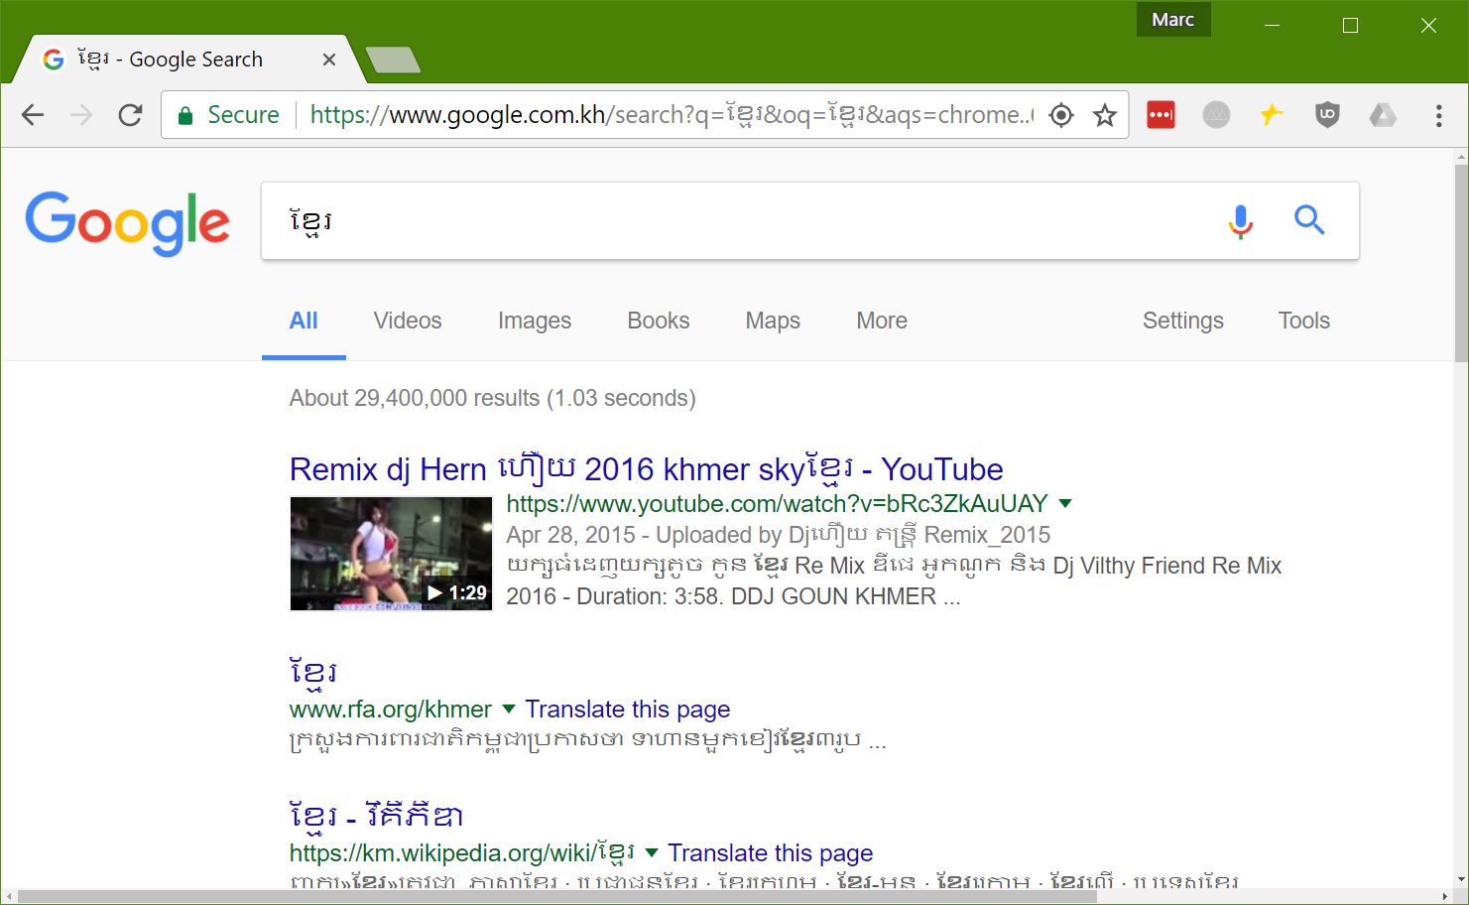
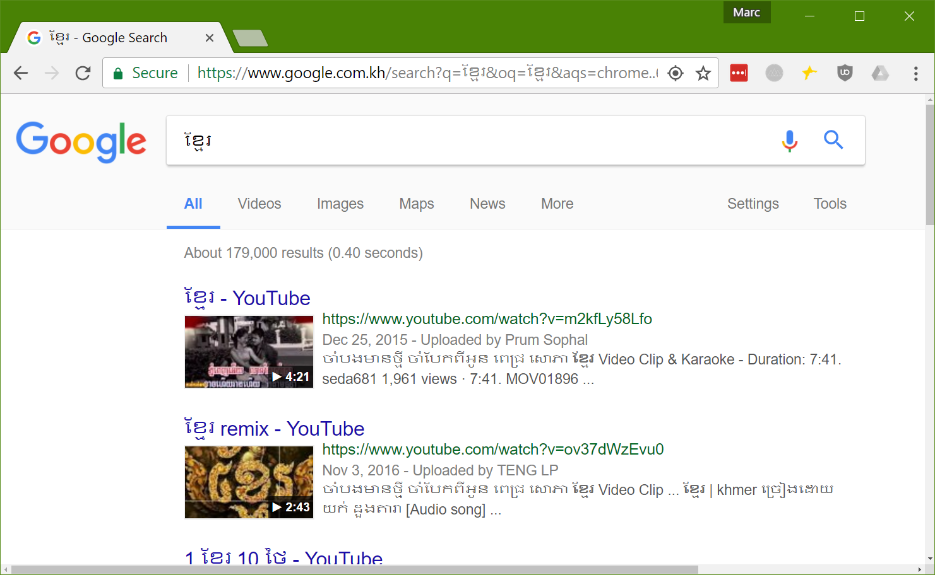
Google Fight: ខ្មែរ vs ខែ្មរ

Slide 30
Typing to match encoding
X J M qE R
X qE J M R

Slide 31
Keyman Code to support “ខ្មែរ”
c This keyboard definition supports only one word: ខ្មែរ
store(&VERSION) '9.0'
store(&NAME) 'Basic Khmer'
begin Unicode > use(main)
group(main) using keys
c Keys for ខ្មែរ
+ [K_X] > U+1781
+ [K_J] > U+17D2
+ [K_M] > U+1798
+ [SHIFT K_E] > U+17C2
+ [K_R] > U+179A

Slide 32
Add a rule to reorder the user’s input
c Keys for ខ្មែរ
+ [K_X] > U+1781
+ [K_J] > U+17D2
+ [K_M] > U+1798
+ [SHIFT K_E] > U+17C2
+ [K_R] > U+179A
c Fixup when user types vowel before coeng+m
U+17C2 U+17D2 + [K_M] > context(2) U+1798 context(1)
ខ
្
ម
ែ
រ
ែ
្
ម

Slide 33
Anatomy of a Keyman keyboard rule
U+17C2 U+17D2 + [K_M] > context(2) U+1798 context(1)
ែ
្
ម
context
keystroke
output
context: what is already on screen (“text store”)
keystroke: what the user types
output: a transform which replaces context in the text store.

Slide 34
Anatomy of a Keyman keyboard rule
U+17C2 U+17D2 + [K_M] > context(2) U+1798 context(1)
ែ
្
1
2
U+17D2
U+1798
U+17C2
្
ម
ែ
context() statement copies a character from the context to the output

Slide 35
Introducing our next word
ស៊ី

Slide 36
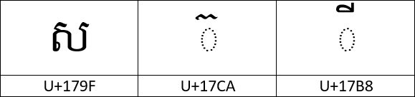
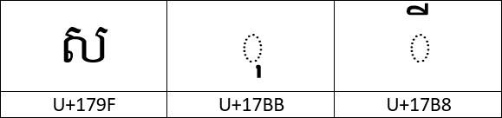
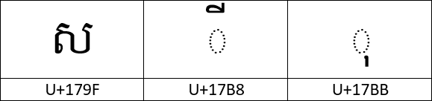
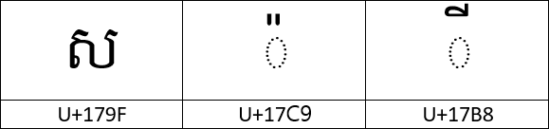
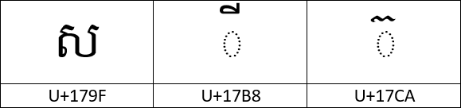
Encoding “ស៊ី”
ស៊ី in Unicode is encoded as:
but people sometimes type:
I love iPhone!

Slide 37
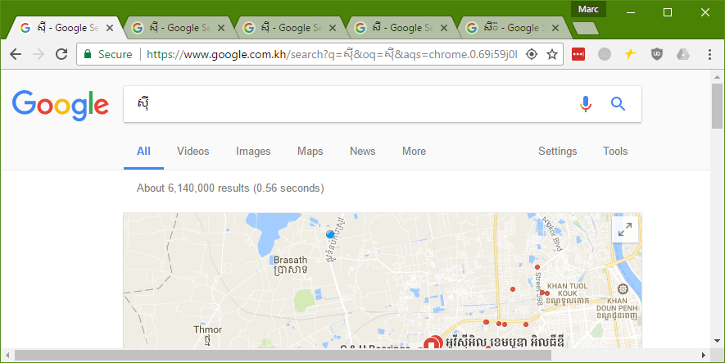
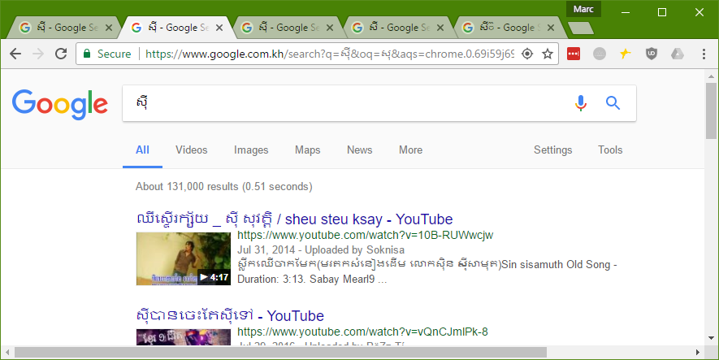
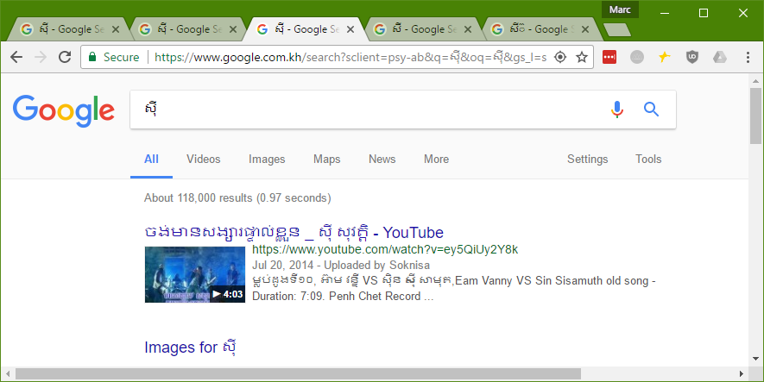
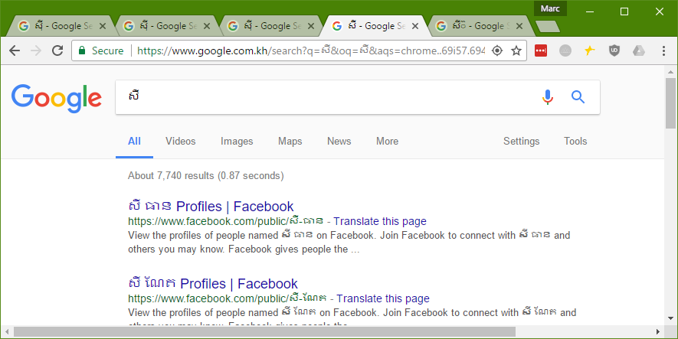
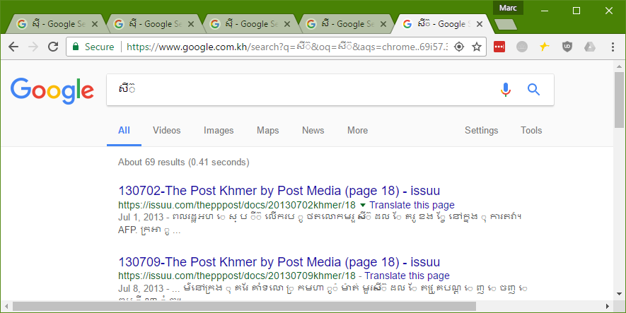
Google Fight: ស៊ី vs សុី vs ...

Slide 38
Typing “ស៊ី”
S / qI
S U qI S qI U

Slide 39
ស៊ី Keyman Code
c This keyboard definition supports only one word: ស៊ី
store(&VERSION) '9.0'
store(&NAME) 'Basic Khmer'
begin Unicode > use(main)
group(main) using keys
c Keys for ស៊ី
+ [K_S] > U+179F c ស
+ [K_U] > U+17BB c ុ
+ [K_SLASH] > U+17CA c ៊
+ [SHIFT K_I] > U+17B8 c ី

Slide 40
Correcting the output
c Keys for ស៊ី
+ [K_S] > U+179F c ស
+ [K_U] > U+17BB c ុ
+ [K_SLASH] > U+17CA c ៊
+ [SHIFT K_I] > U+17B8 c ី
c Fixup when user types in the wrong letter
U+179F U+17BB + [SHIFT K_I] > context(1) U+17CA U+17B8
U+179F U+17B8 + [K_U] > context(1) U+17CA context(2)

Slide 41
Correcting the output – analysis
U+179F U+17BB + [SHIFT K_I] > context(1) U+17CA U+17B8
U+179F U+17B8 + [K_U] > context(1) U+17CA context(2)
Can you suggest a rule to correct this mistake?
ស
ុ
៊
ី
ស
ី
៊

Slide 42
Keyboard Rules - Summary
Reorder to fix mistyped words - ខ្មែរ
Block invalid keystrokes - ស៊ី + ី
Substitute incorrect letters - ស៊ី
Combine decomposed letters - េ + ី  ើ
Break Apart composed letters

Slide 43
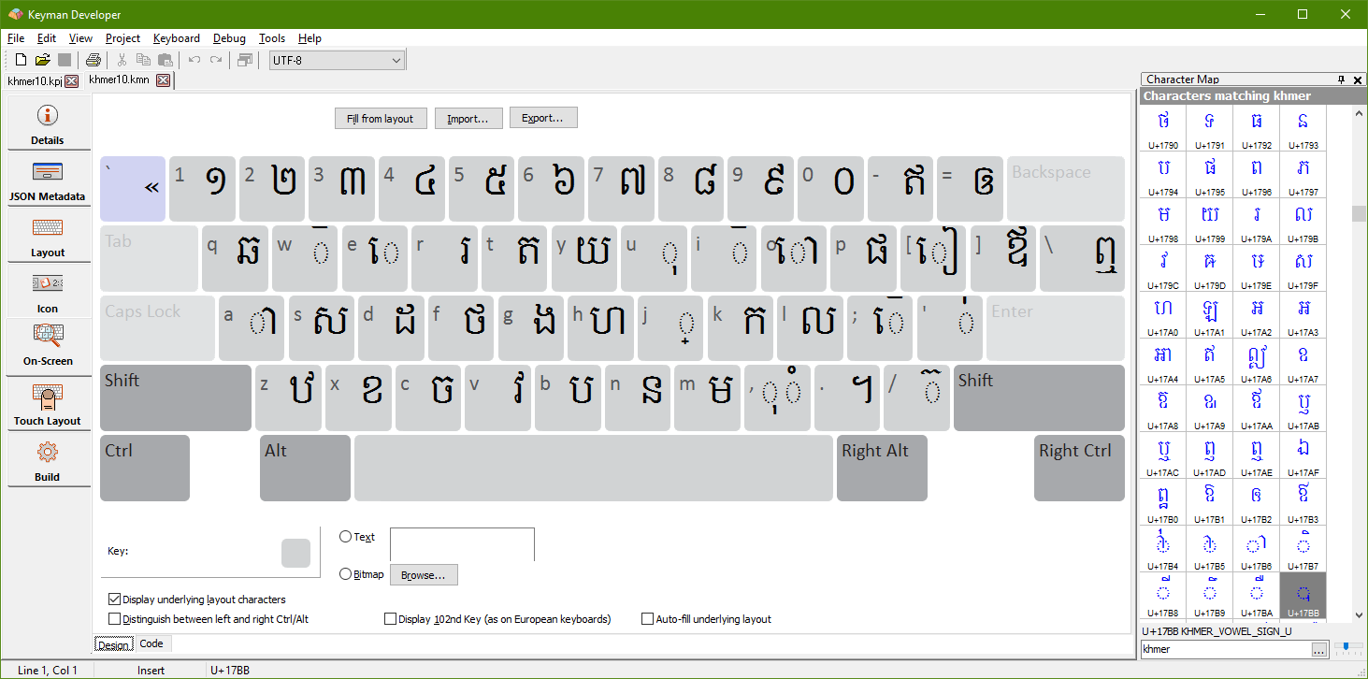
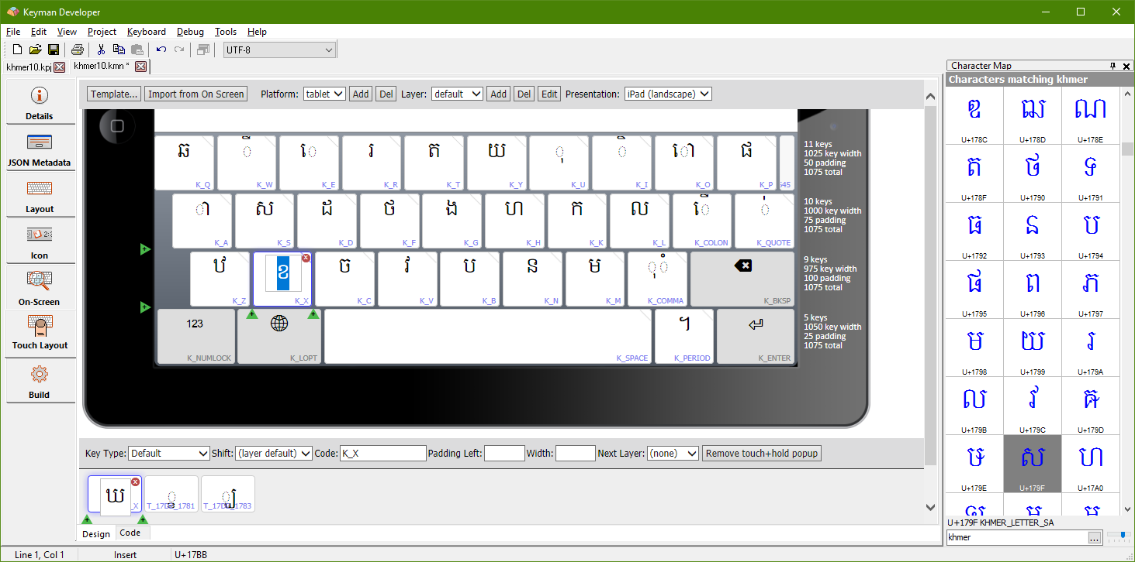
Multiplatform Keyboards
Keyman Developer rules apply on every platform
But presentation of the keyboard can vary
Import basic layout from Desktop to Touch
Optimise for use on small devices

Slide 44
Deploying Keyboards
Create a keyboard layout in Keyman Developer
Push to GitHub
Create a Pull Request on https://github.com/keymanapp/keyboards.git
When accepted, the layout is automatically available on every device through Keyman keyboards menu
Full details at https://help.keyman.com/developer/keyboards

Slide 45
Question and Discussion Time
Learn more:
www.keyman.com
www.sil.org

